Slide 1

DOMESTIC POWER CONSUMPTION DATA ANALYSIS AND REPORTING USING POWER BI

Slide 2










Trusted Full IT Services Partner since 2010
WHO WE ARE
50+ Clients, 3000+ projects delivered across US, UK, Canada,
Australia, India and ASEAN
550+ career engineers based out of US and India
Centers of Excellence into all Service areas and New Technologies
Mobile Devices and IOT Labs
ISO 27001 and ISO 9001 External surveillance
audit and renewals
CMMi Level 3 – DEV 2.0 Certified
Comply with SOC 2 – Type II
Comply HIPAA regulations
ISO 27001: 2013 | ISO 9001:2015
| CMMi Level 3 certification | SOC2 Certified| HIPAA Certified
24/7 NOC Support
Irving TX, US | Hyderabad, India
MotivityLabs © Copyright 2022. All Rights Reserved.

Slide 3
SERVICES OVERVIEW
PRODUCT ENGINEERING
DEVOPS/CLOUD
ROBOTIC PROCESS AUTOMATION
Custom Application Development
Integration between Applications
Application/ Cloud Migrations
Mobile Application Development
App Support & Maintenance
All Cloud platform support (AWS, Azure, GCP)
Continuous Integration
Continuous Deployment
Continuous Testing
Continuous Monitoring
Continuous Feedback
Kofax
UIPath
Automation Anywhere
Blue Prism
QUALITY ASSURANCE
DATA SCIENCE/ENGINEERING
ENTERPRISE SECURITY
Functional Testing
Compatibility Testing
Localization Testing
Compliance Testing
Test Automation
Web Services/APIs
Load Testing & Capacity Assessment
Predictive Analysis
BI Architecture
R Language
Python
Data Modelling & Warehousing
Data Mining
ETL
Custom Dashboards
Configuration & Migration
Advanced Threat Management
Cyber and Infra Security
Identity and Access Management
Governance, Risk and Compliance
Center of Excellence (CoE): Continuous research, Dedicated labs, Accelerators, Value additions

Slide 4

OUR EXPERTISE
PRODUCT ENGINEERING
PROJECT MANAGEMENT
TOGAF Certified
Full Stack Developers
Cloud Practitioner & Architects
Big Data Platform Architects
PMSPC 5.0
SAFe Agilist
Certified Scrum Master
Lean SixSigma
P, PMI-ACP
DEVOPS/CLOUD
ENTERPRISE SECURITY
AWS Certified Professionals
Azure Certified Professional
MCSE
RHEL
CEH – Certified Ethical Hacker
OSCP – Offensive Security Certified Professional
CISSP - Certified Information Systems Security Professional
AWS – AWS Certified Security
– Specialist
DATA ENGINEERING
Microsoft Certified: Data Analyst
Tableau
Power BI
QUALITY ASSURANCE
ISTQB Certified Engineers
Certified Information Systems Security Professional

Slide 5
Problem statement
Without a Data model and Data visualization tools, it takes a lot of manual work to Analyze CSV files and do the required computations before producing reliable reports for business decisions.
(Processing Source CSV files and generating visual excel report manually taking time)
Existing Dataflow
Raw files
(Telangana Portal)
Manual Processing
Manually generated Excel Reports

Slide 6
Proposed Solution
Our solution: Azure Data Factory (ADF) with SQL Cloud Storage
In order to Automate the existing manual data processing using excel, We are building data pipeline using Azure Data Factory(ADF). The raw files are loaded to Azure Container and ingested to Data Azure SQL Database for storing structured data and built reports on top of it using Power BI tool.
Data-flow diagram:
Azure Data Factory
Azure Container
Azure SQL Database
Power Bi Reports
Raw files
(CSV)

Slide 7
SCOPE
IN-SCOPE
Data Extraction
Data Cleansing
Data Processing
Data Storage
Data Visualization

Slide 8
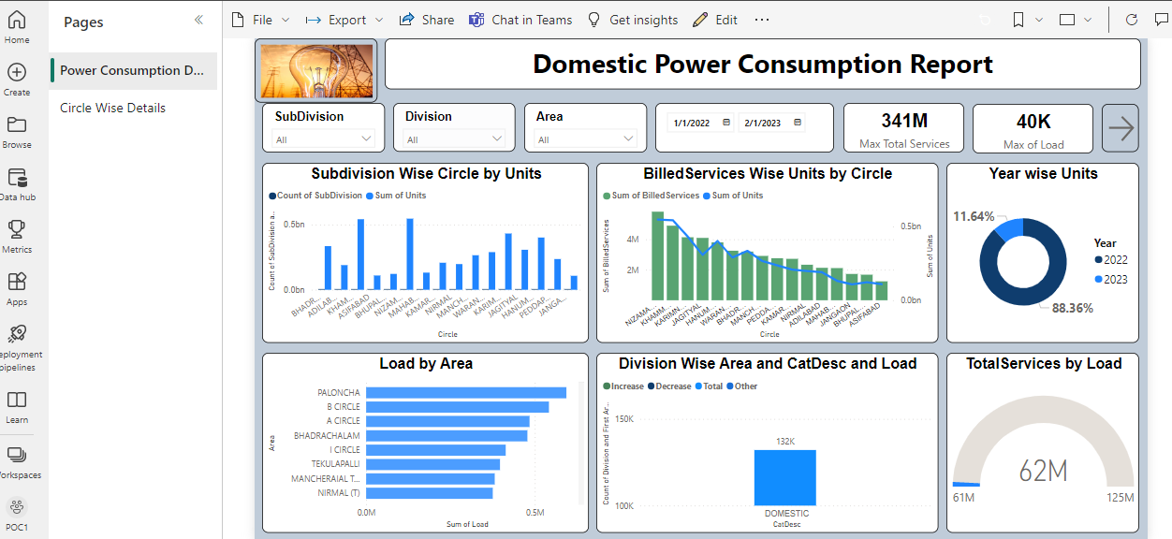
Power BI Report – Page 1

Slide 9
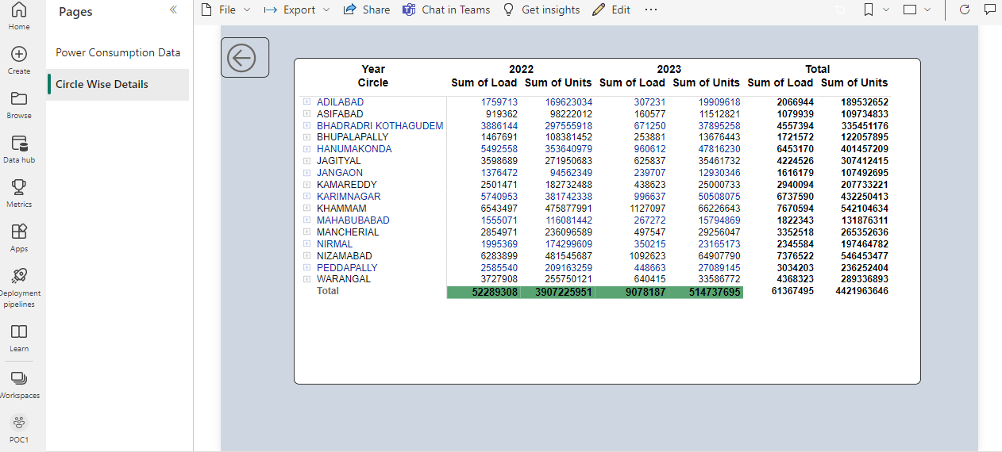
Power BI Report – Page 2

Slide 10
Low-Level and High-Level Design Document find below link
Detail level design document.docx
High Level Document.docx

Slide 11

QUESTIONS?

Slide 12


Address:
222 W. Las Colinas Blvd. Suite 755E Irving, TX 75039
Contact Numbers:
© +1 469-393-0278
Email Address:
pavan.nair@motivitylabs.com
The contents of this presentation are confidential and intended solely for the use of the individual or entity to whom they are addressed. The company accepts no liability for any damage caused by using the content of this presentation.

Slide 13
THANK YOU

